Slide 1
CHAPTER – 2
NETWORK MODELS

Slide 2
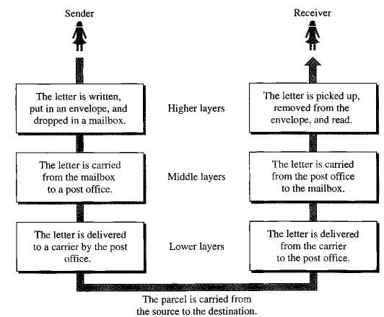
LAYERED TASKS

Slide 3
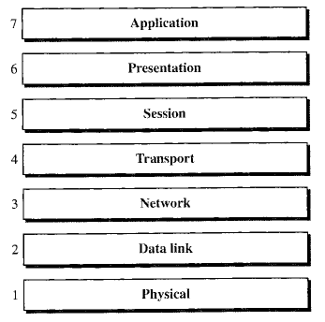
OSI MODEL
Open System Interconnection model => 7 layers

Slide 4
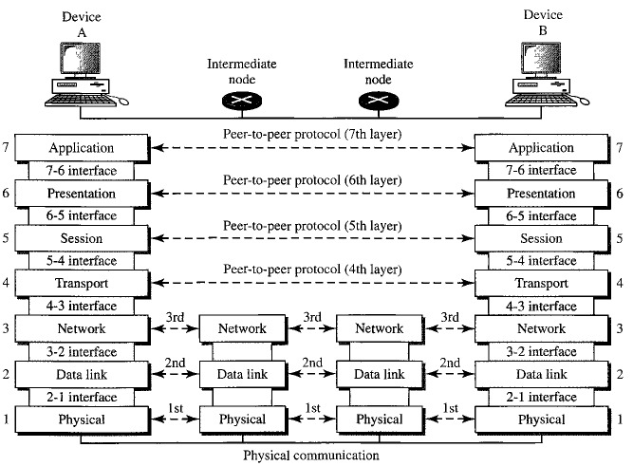
THE INTERCONNECTION BETWEEN LAYERS

Slide 5
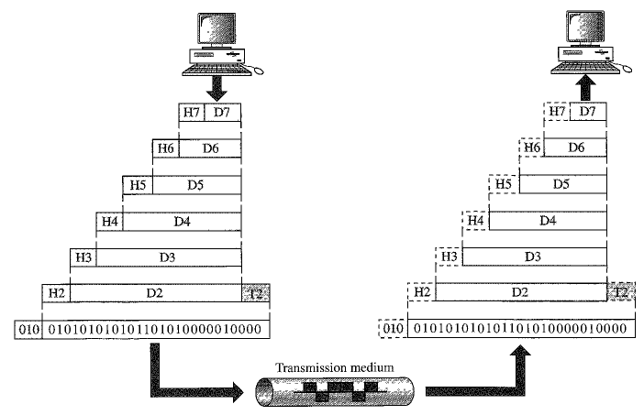
AN EXCHANGE USING OSI MODEL

Slide 6
ORGANIZATION OF LAYERS
Layers 1, 2 and 3 – Physical, Data link and Network layers are network support layers.
They deal with the aspect of moving data from one device to another
Layers 5, 6 and 7 – Session, Presentation and Application layers are user support layers.
They allow interoperability among unrelated software systems
Layer 4, the Transport layer, links the two subgroups of network support layer and user support layer

Slide 7
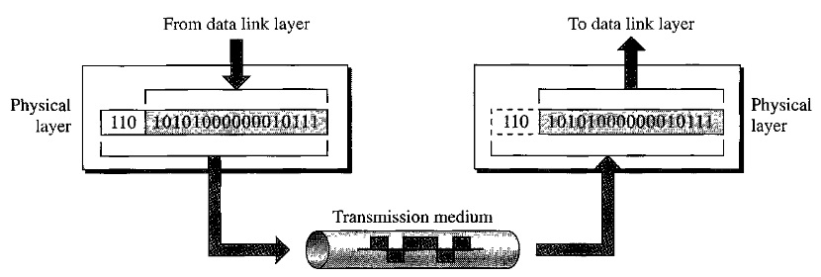
PHYSICAL LAYER
The physical layer coordinates the functions required to transmit a bit stream over a physical medium.
It deals with the mechanical and electrical specifications of the interface and transmission medium.

Slide 8
PHYSICAL LAYER TASKS
Physical characteristics of interfaces and medium
Representation of bits
Data rate
Synchronization of bits
Line configuration
Physical topology
Transmission mode

Slide 9
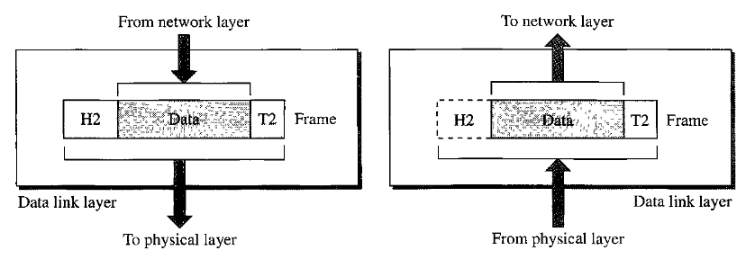
DATA LINK LAYER
The data link layer is responsible for delivering data units from one hop (node) to the next without errors.
It makes the physical layer appear error free to the upper layer

Slide 10
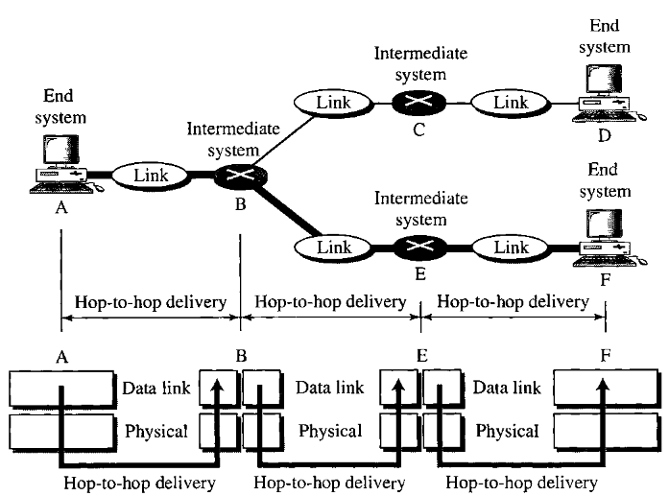
DATA LINK LAYER – HOP-TO-HOP DELIVERY

Slide 11
DATA LINK LAYER TASKS
Framing
Physical addressing
Flow control
Error control
Access control

Slide 12
NETWORK LAYER
The network layer is responsible for the source-to-destination delivery of a packet across multiple network links.
If two systems are connected to the same network, there is usually no need for a network layer. However, if the two systems are attached to different networks with connecting devices between the networks, there is often a need for the network layer to accomplish source-to-destination delivery.

Slide 13
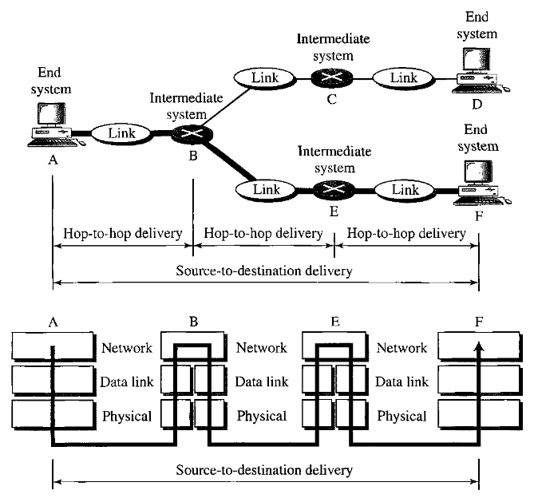
NETWORK LAYER – SOURCE-TO-DESTINATION DELIVERY

Slide 14
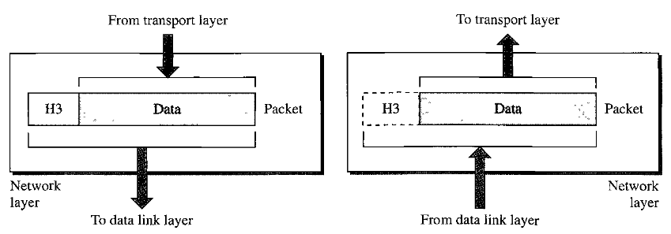
NETWORK LAYER TASKS
Logical addressing
Routing

Slide 15
TRANSPORT LAYER
The transport layer is responsible for the process-to-process delivery of the entire message. A process is a program running on a host.
Network layer ensures source-to-destination delivery of individual packets, but it does not recognize any relationship between those packets.
The transport layer, on the other hand, ensures that the whole message arrives intact and in order, ensuring both error control and flow control at the source-to-destination level.

Slide 16
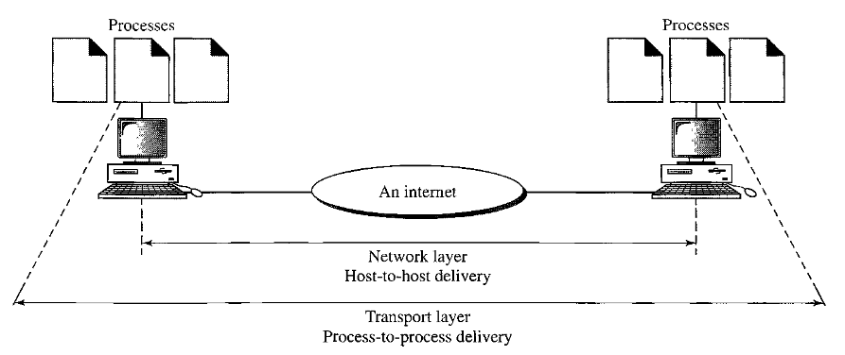
TRANSPORT LAYER – PROCESS-TO-PROCESS DELIVERY

Slide 17
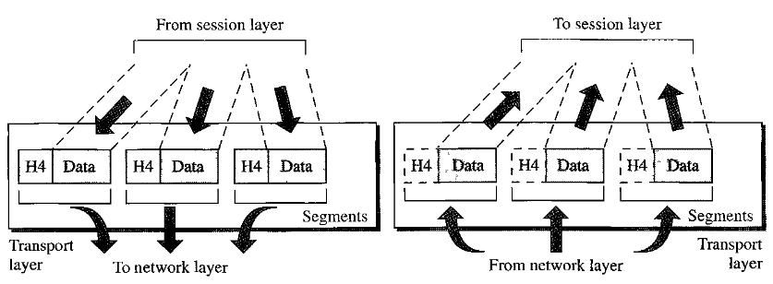
TRANSPORT LAYER TASKS
Service point/ Port addressing
Segmentation and reassembly
Connection control
Flow control
Error control

Slide 18
SESSION LAYER
The session layer establishes, maintains, and synchronizes the interactions between communicating devices.
Session layer is the network dialog controller.
It is responsible for dialog control and synchronization

Slide 19
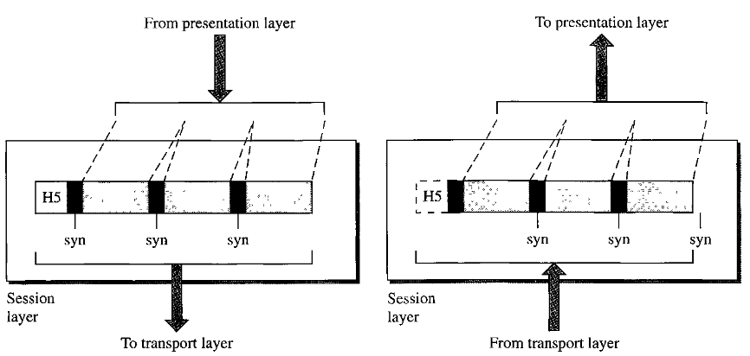
SESSION LAYER TASKS
Dialog control
Synchronization

Slide 20
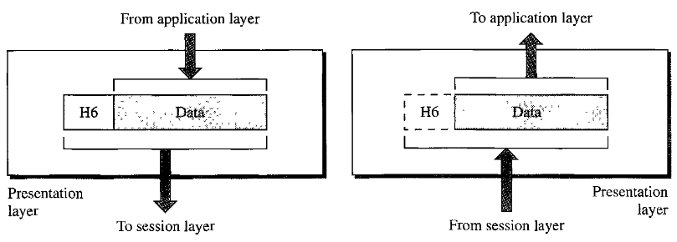
PRESENTATION LAYER
The presentation layer is concerned with the syntax and semantics of the information exchanged between two systems.

Slide 21
PRESENTATION LAYER TASKS
Translation
  Different computers use different encoding systems, the presentation layer is responsible for interoperability between these different encoding methods.
Encryption
  The message is changed into a format in sender and transmits that. In receiver, the encrypted message is transformed back to its original form
Compression
  Compressing data so that it will be transmitted first

Slide 22
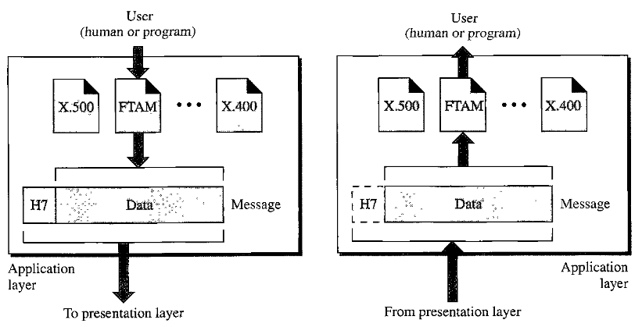
APPLICATION LAYER
The application layer enables the users to access the network.

Slide 23
APPLICATION LAYER TASKS
Network virtual terminal
  A network virtual terminal is a software version of a physical terminal, and it allows a user to log on to a remote host.
File transfer, access and management
Mail services
Directory services

Slide 24
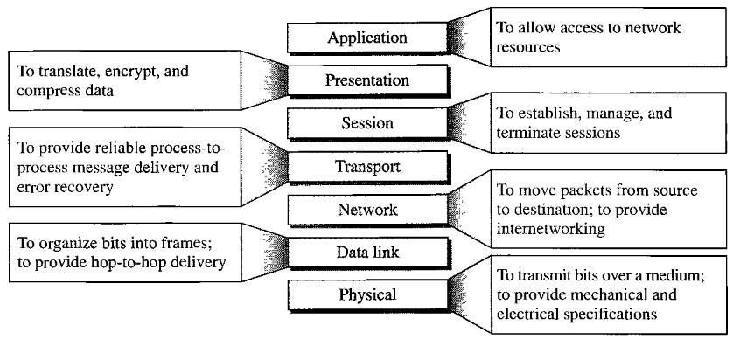
SUMMARY OF LAYERS

Slide 25
TCP/IP PROTOCOL SUITE
The TCP/IP protocol was developed prior to OSI
Layers in TCP/IP
  Physical Layer
  Data Link layer
  Internet (Network) layer
  Transport layer
  Application layer

Slide 26
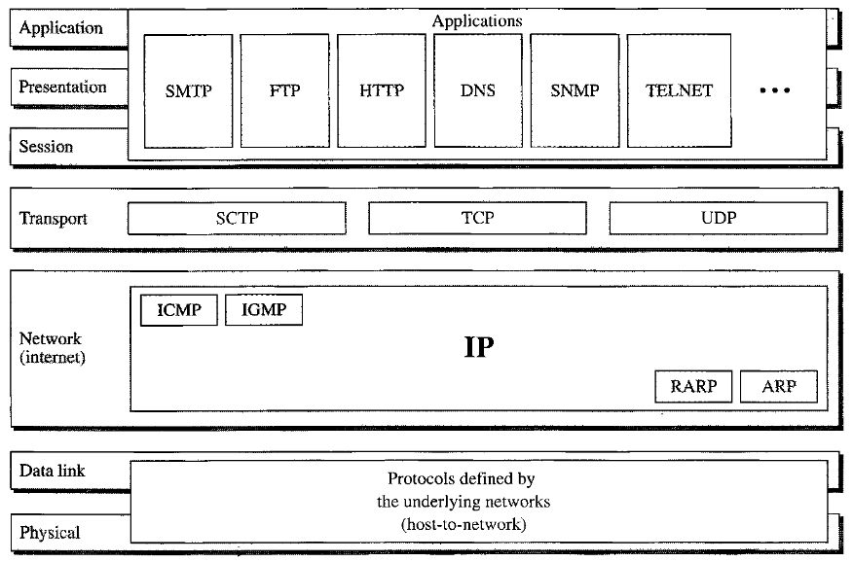
TCP/IP PROTOCOL AND OSI MODEL

Slide 27
NETWORK LAYER PROTOCOLS
Internetworking Protocol (IP)
Address Resolution Protocol (ARP)
Reverse Address Resolution Protocol (RARP)
Internet Control Message Protocol (ICMP)
Internet Group Message Protocol (IGMP)

Slide 28
IP
Unreliable and Connectionless protocol – a best effort delivery service
Best effort means IP provides no tracking or error checking
IP assumes the unreliability of the underlying layers and does its best to get a transmission through to its destination, but with no guarantees.
IP transports data in packets, called datagrams, each of which is transported separately

Slide 29
ARP AND RARP
ARP is used to find the physical address when its internet(IP) address is known
RARP is the reverse of ARP
RARP is used to find the IP address when its Physical address is known

Slide 30
ICMP AND IGMP
ICMP is a mechanism used by hosts and gateways to send notification of datagram problems back to the sender.
ICMP sends query and error reporting messages.
IGMP is used to facilitate the simultaneous transmission of a message to a group of recipients.

Slide 31
TRANSPORT LAYER PROTOCOLS
User Datagram Protocol (UDP)
Transmission Control Protocol (TCP)
Stream Control Transmission Protocol (SCTP)

Slide 32
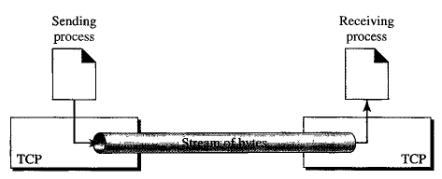
TCP
TCP is a reliable connection-oriented protocol that provides full transport-layer services to applications. A connection must be established between both ends of a transmission before either can transmit data.
At the sender, TCP divides a stream of data into smaller units called segments. Each segment includes a sequence number for reordering. At the receiver, TCP collects, reorders and assembles the segments based on sequence numbers.

Slide 33
UDP AND SCTP
UDP is the simpler of the two standard TCP/IP transport protocols. It is a connectionless, unreliable process-to-process protocol that adds only port addresses, checksum error control, and length information to the data from the upper layer.
SCTP provides support for newer applications such as voice over the Internet. It is a transport layer protocol that combines the best features of UDP and TCP.

Slide 34
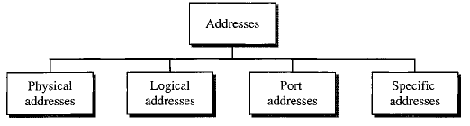
ADDRESSING
Four levels of addresses are used in internet employing the TCP/IP protocols

Slide 35
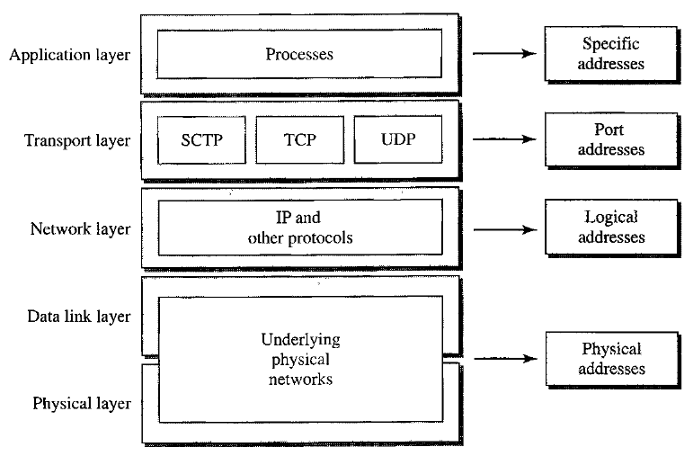
RELATIONSHIP OF LAYERS AND ADDRESSES

Slide 36

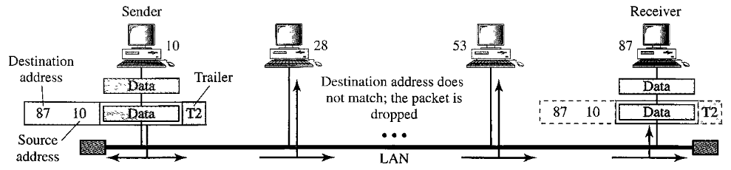
PHYSICAL ADDRESS
Physical address is the address of a node as defined by its LAN. It is the lowest level address
A 48 bit physical address is included in the frame used by the data link layer.

Slide 37
LOGICAL ADDRESS
Logical address is a kind of address that can uniquely identify each node in an internetwork environment, regardless of the underlying physical network.
A logical address in the Internet is currently a 32-bit address that can uniquely identify each host. It is known as IP address.
No two publicly visible node can have same IP address!
206.54.129.98

Slide 38
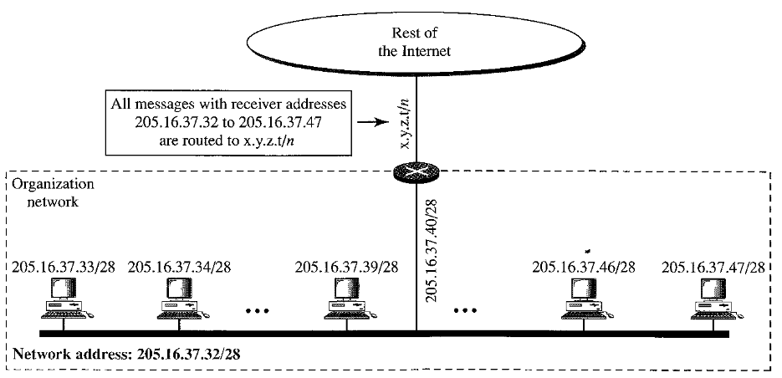
IP ADDRESS

Slide 39

PORT ADDRESS
The Port address identifies a process on a host.
The end objective of Internet communication is a process communicating with another process. There should be some address to uniquely identify a process.
The Port address in TCP/IP is 16 bits in length.

Slide 40
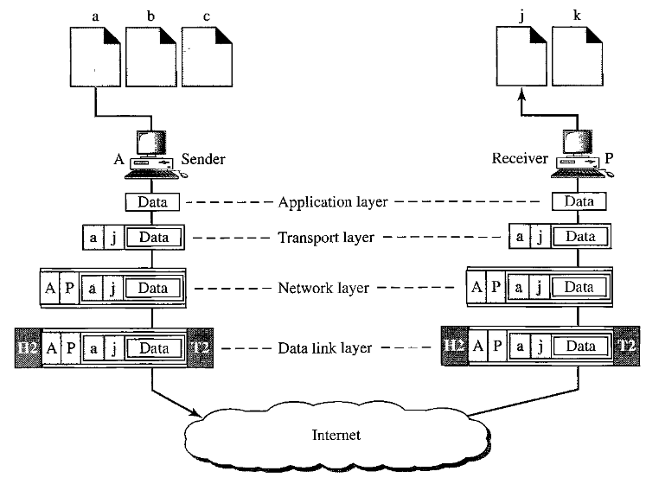
PORT ADDRESSES
The physical address change from hop to hop, but the logical and port address usually remain the same!

Slide 41
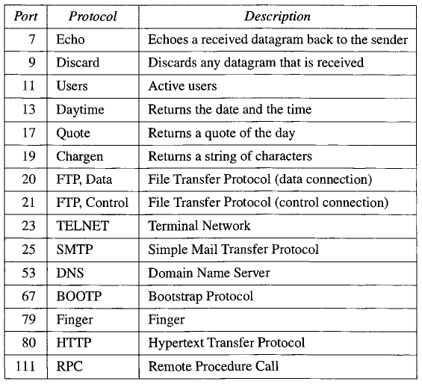
WELL KNOWN PORT ADDRESSES USED BY TCP

Slide 42
SPECIFIC ADDRESS
Some applications have user-friendly addresses that are designed for that specific address.
For example, e-mail address (e.g., forouzan@fhda.edu) and Universal Resource Locator (URL) (e.g., www. mhhe.com). The first defines the recipient of an e-mail; the second is used to find a document on the World Wide Web.
These addresses, however, get changed to the corresponding port and logical addresses by the sending computer.

